Slide 1




Contributing and Understanding Docs
PRESENTED BY

Slide 2



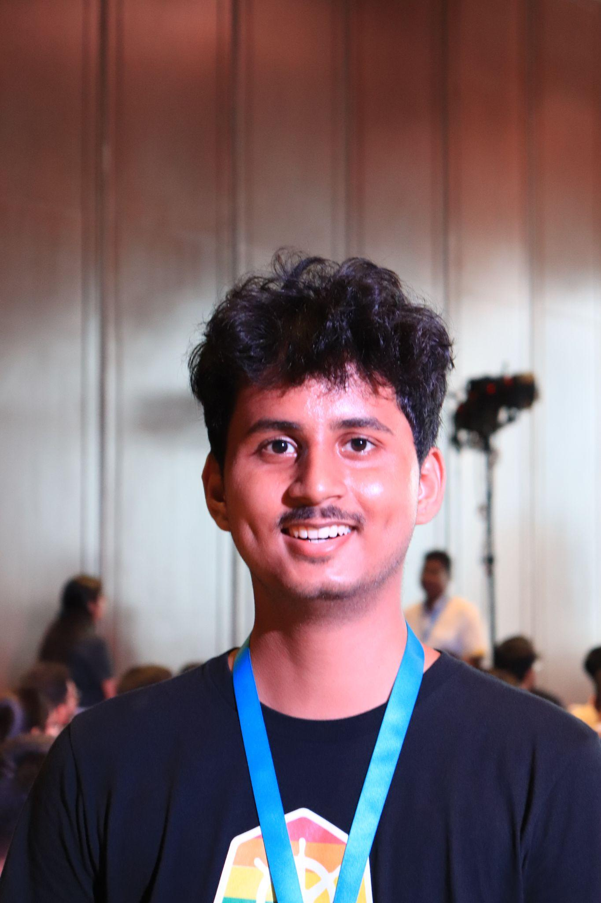




Intern @ Harness.io
Technical Writer
DigitalOcean Navigator
GitHub Campus Expert
Google Venkat Scholar
Hrittik Roy
2022 HACKTOBERFEST. ALL RIGHTS RESERVED

Slide 3
DigitalOcean / Agenda
Agenda:
Understanding Documentation
Why Documentation?
Important Files for you to Start
Contributing to Documentations
Some Tips
2022 HACKTOBERFEST. ALL RIGHTS RESERVED

Slide 4
Why
Documentation?
Hacktoberfest
2022 HACKTOBERFEST. ALL RIGHTS RESERVED

Slide 5




It Helps:
Contributors
You
Users
Help first time Contributors onboard
For you who will be using your Code in some months
Quick Start Guide, Show your project exists
2022 HACKTOBERFEST. ALL RIGHTS RESERVED

Slide 6







DigitalOcean / Sponsorship
Readme.md
Talks about the functionality of your project, links to other docs
Min Components of
License
Documentation
License so that others are free to use, change, and distribute the software. Truly #oss
Contributing.md
Help new contributor to setup build environment, dependencies and create PR
2022 HACKTOBERFEST. ALL RIGHTS RESERVED

Slide 7






DigitalOcean / The legacy
There’s More
02.
Examples and galleries
Small samples to test your application
01.
Literal documentation or Installation instructions
04.
Tutorials/Guides/FAQs
Whatever helps users/you/contributor
03.
API documentation
Use/Understand Function
Understand Arguments/Default Value of Function
2022 HACKTOBERFEST. ALL RIGHTS RESERVED

Slide 8
Contributing to Documentation
Hacktoberfest
2022 HACKTOBERFEST. ALL RIGHTS RESERVED

Slide 9
DigitalOcean / Sponsorship
Read the Docs
Understanding aspects of Project
Value of
Build your Docs
Starting
Docs run on different templates/engines so run them on your local setup!
Open collaboration
Collaborate on Issues/PRs and commit!
2022 HACKTOBERFEST. ALL RIGHTS RESERVED

Slide 10







DigitalOcean / The legacy
Contributions
Types of
Grammar
Translation
Logic
Fix the Grammar as you go!
Help the project to migrate to different languages!
Fix issues you faced while running the docs!
Bonus: Diagrams
2022 HACKTOBERFEST. ALL RIGHTS RESERVED

Slide 11
Advice
Towards
Documentation
Hacktoberfest
2022 HACKTOBERFEST. ALL RIGHTS RESERVED

Slide 12




DigitalOcean
Documentation
Values
DOCUMENTATION IS LIKE CODE: IT NEEDS TO BE MAINTAINED
• Favor quality over quantity.
• All examples in the documentation should run automatically
IF IT IS NOT DOCUMENTED, IT DOES NOT EXIST
• Write documentation as you write code.
• Documentation driven development.
DOCUMENTATION IS ABOUT COMMUNICATION
• How to organize your ideas?
• Your Target Audience?
2022 HACKTOBERFEST. ALL RIGHTS RESERVED
2022 HACKTOBERFEST. ALL RIGHTS RESERVED

Slide 13


DigitalOcean / The legacy
Let’s do
QnA
2022 HACKTOBERFEST. ALL RIGHTS RESERVED

Slide 14
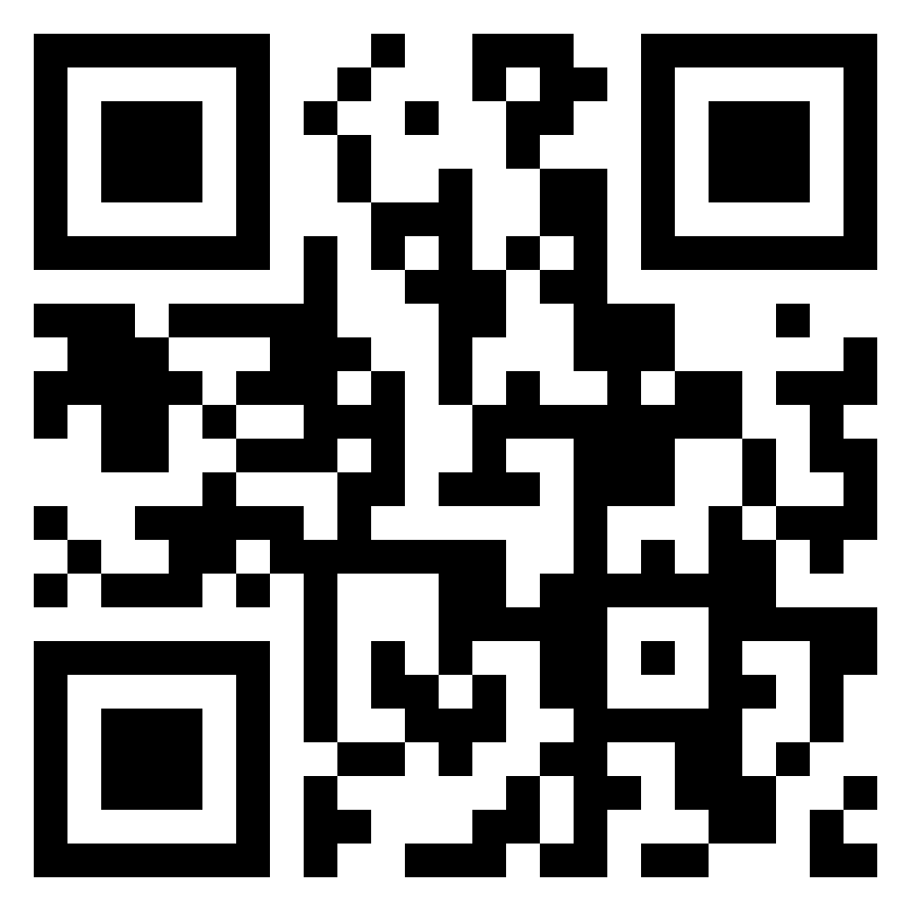
DigitalOcean / The legacy
linktr.ee/hrittikhere
2022 HACKTOBERFEST. ALL RIGHTS RESERVED

